Slide 1
C++ Programming Today 2nd Edition By Barbara Johnston Chapter 4
Instructor: Rob Garner
Lecture Slides by Kelly Montoya and Rob Garner

Slide 2
Overview
Basic Function Characteristics
Types of functions
Calling and Called Functions
How to write functions
Return Statement
Function Calls
Function variables
Troubleshooting Functions
Overloaded Functions
Default Parameter Lists
Variable Scope
Multi-File Programs
String Stream Class
Common Errors With Functions

Slide 3
Function Calls
Explain how functions access variables and parameters.

Slide 4
Function Calls
The call statement is the C++ statement where the called function is accessed.
When a function is called, control is passed to the called function, and the statements inside that function are performed.
Control is returned to the calling function when the function tasks are completed.
The call statement requires that just the variable names be used.

Slide 5
Function Calls
The function calls in the C++ Hotel program are:
numPeople = HowManyPeople();
numNights = HowManyNights();
roomType = WhatTypeRoom();
totalCost = CalcCost(numPeople, numNights, roomType);
WriteCostSummary(numPeople, numNights, roomType, totalCost);

Slide 6
Functions that have no Inputs and No Return Value
When a function does not have any inputs, nor does it return anything to the calling function, the call statement is very simple.
The WriteGreeting() function is like this, and must be called like so:
WriteGreeting();

Slide 7
Functions that have no Inputs but have a Return Value
When a function does not have any inputs, but it does return a value, you have to be sure the call statement has an assign operator so that the returned value is placed in a variable.
Note how the input list parentheses are empty, but the return values are each assigned to one of main’s variables.
numPeople = HowManyPeople();
numNights = HowManyNights();
roomType = WhatTypeRoom();

Slide 8
Functions that have input and No Return Values
When a calling function must pass information to the called function, but the function doesn’t return anything, the call statement does not have an assign operator.
When this program writes the resultant cost summary to the screen, this task is done by the WriteCostSummary() function. The function doesn’t return any value to us.
WriteCostSummary(numPeople, numNights, roomType,totalCost);

Slide 9
Functions that Input and Return Values
When a calling function must pass information to the called function, and that function returns a value to us, we need be have an assign statement to obtain that value.
Here is the call to CalcCost(), which returns to us the total cost of the stay.
totalCost = CalcCost(numPeople, numNights, roomType);

Slide 10
Call by Value
A call by value copies the value of the variable into the input parameter variables of the called function when the data is passed to the function.
In the C++ Hotel program, each function has its own copy of the variables that it needs.

Slide 11
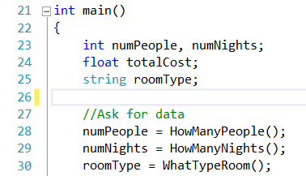
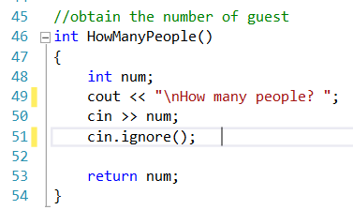
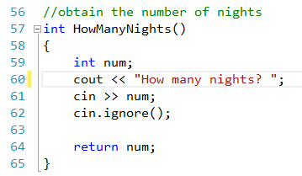
numPeople
numNights
totalCost
roomType
Variables from main not available to HowManyPeople!
They are “Out of scope”
num
5
Once HowManyPeople provides it’s value.
num goes out of scope!
Not the same variable!
num
3
Once HowManyNights provides it’s value.
num goes out of scope!

Slide 12
Call by value:
copies the variable into the input parameter variables of the called function when the data is passed to the function.
copies a pointer to the variable into the input parameter variables of the called function when the data is passed to the function.
copies the value of the variable into the input parameter variables of the called function when the data is passed to the function.
None of the above.

Slide 13
Write the prototype of a function called MultipleChars that returns a string and takes two parameters: a char called charToRepeat and an int called numChars

Slide 14
Function variables
Explain how variable names are used in functions.

Slide 15
Function Variable “ownership”
Variable names do not have to be the same from function to function. The Sum 1 to N program shows this.
The main() function has the variables “x” and “sum.”
In the Get_Number() function, the variable holding the user’s number is “number”
In the Add_1_to_N(), the number is just “n.”

Slide 16
Function Variable “ownership”
int Get_Number() //Function header line
{ // returns “number”
int number;
cout <<"\n Enter a number ";
cin >> number;
return number;
}
Notes:
From Program 4-4.

Slide 17
Function Variable “ownership”
int Add_1_to_N(int n) //Function header line
{ // input is “n”
int total = 0,i;
for(i = 1; i <= n; ++i)
{
total = total + i;
}
return total;
}

Slide 18
Function Variable “ownership”
Parameter in function definition is called n here it is passed in as an argument called x.
int main()
{
int x,sum;// using names x and sum
x = Get_Number();//call to function to get the user's number
sum = Add_1_to_N(x); //pass x, adder returns the sum
cout << "\n The result from adding 1 + 2 + ... + "
<< x << " is " << sum << endl;
return 0;
}
It doesn’t matter the name of the variable being
passed and received, just the data type.

Slide 19
Function Variable “ownership”
The sum value in main is represented as the total value in the Add_1_to_N() function.
When variables are declared in a function header line or within the function itself, the variables are local to (are “owned” by) that function.
They are not seen by any other function.

Slide 20
Function Variable “ownership”
Functions have their own copies of the variables.
These variables are referred to as local variables.
Notes:
Program 4-4 shows different variable names in functions.

Slide 21
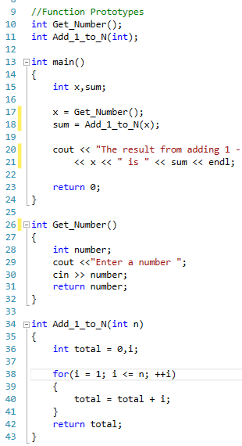
x
sum
8
The result from adding 1 – 8 is 36
number
8
n
total
i
10
15
21
28
36
1
3
6
1
2
3
4
5
6
7
8

Slide 22
Troubleshooting Functions
Explain how to troubleshoot functions.

Slide 23
Troubleshooting: Undeclared identifier
A data variable declared inside main() can’t be seen by all other functions.
Remember, that each standalone function must have its own data variables.
Compiler errors:
asknameagefunc.cpp(47) : error C2065: 'age' : undeclared identifier
asknameagefunc.cpp(56) : error C2065: 'name' : undeclared identifier
Notes:
Program 4-5 shows what happens when variables aren’t seen by other functions.

Slide 24
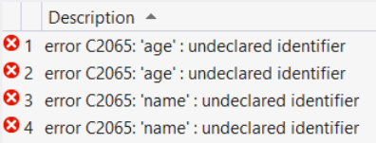
int main()
{
int age;//this is main’s age, name
string name;
age = AskForAge();
name = AskForName():
//rest of main
}
int AskForAge()//variable for age not here
{
cout << "\n How old are you?";
cin >> age;//compiler error here!
return age;
}
string AskForName() //variable for name not here
{
cout << "\n What is your name?";
getline(cin, name);//compiler error here!
return name;
}
Notes:
From Program 4-4.

Slide 25
Overview
Basic Function Characteristics
Types of functions
Calling and Called Functions
How to write functions
Return Statement
Function Calls
Function variables
Troubleshooting Functions
Overloaded Functions
Default Parameter Lists
Variable Scope
Multi-File Programs
String Stream Class
Common Errors With Functions

